Slide 1
INTRODUCTION TO JMS
September 10, 2016

Slide 2
JMS Introduction
Motivation for the JMS
Point to Point Mesaging
Publisher Subscriber Messaging
JMS API Architecture
Administrative Objects
Other JMS Objects
Message Producer
Message Consumer
Message Acknowledge
Durable Subscriber
JMS Reply Mechanism
Message Properties
JMS Transaction
Scenarios - Recap
JMS – Spring Integration (Self – study)

Slide 3
Objectives
Understanding need for JMS
Understanding JMS API architecture
Understanding JMS terminology
Understanding types of messaging domains in JMS
Understanding JMS programming model
Understanding message properties
Understanding JMS Transaction
Understanding JMS-Spring Integration

Slide 4

Introduction
In early days of programming, communication between two systems/application was done via low level network programming using JAVA Socket API.
Both, server and client have programming logic and need to share the programming data like classes and interfaces.
Client and server both are called thick.
Calls between two application are synchronous calls.
Classes + Business Logic + Networking
Server
Synchronous call: Client send a request to server and server send a response immediately. Client is supposed to handle the response. If the server takes time to generate the response, client has to wait and can not proceed with other requests.
Classes + Business Logic + Networking
Socket Programming
Client
Notes:
[SK]
- Question: what does it mean by 'Thick‘; what is synchronous?
- Advice the group that socket programming is still prevalent in some scenarios. ex: PCML application
- Ask the group, where socket programming might be advantageous over JMS … probably speed. And more so when synchronous comm. Is desired

Slide 5
Introduction Cont…
Low level socket programming was replaced by Remote Method Invocation (RMI) mechanism in later days.
Client invoke a remote method published by the server and the business logic is executed on the server.
Server share JAVA interfaces with the client.
Client is called a thin client.
Calls between two application are synchronous calls.
Remember: RMI is only a Java specific solution.
Classes + Business Logic + Skeleton
Server
If the server application is down, client call is lost and can not retrieved.
Interface + Stub
RMI
Client
Notes:
[SK] Don’t need to know too much about this. Just should know that there is a RMI kind of solution.
Point to remember is that RMI will only work in Java world. A Java app cannot communicate (by default) with .NET app using RMI.

Slide 6
Limitations of Socket Programming and RMI
Calls are synchronous. If server response late, client has to wait for the response.
Client call is lost if the server is down.
Client must have knowledge about the server and vice-versa.?
Server has to share some programming data (at least interfaces) with the client.
Server
Client

Slide 7
Design Problem #1:
I want to communicate with another system.
I do not want to wait for an acknowledgement from destination system (Asynchronous)

Slide 8

Motivation for the JMS
Java messaging service is an specification for the asynchronous communication between two parties. This specification is implemented by different MOM (Message Oriented Middleware) servers.
Messages are the objects that communicate information between applications.
Messages are send/published to a MOM server by the source client.
Messages are received/subscriber from the MOM server by the target client.
Client of an JMS application need not have the information of the server ?
JMS ensure the delivery of the information (No information lost).
Programming data between two parties need not be shared.
To simplify:
MOM API === JMS API;
Send === Publish
Receive === Subscriber
Notes:
[SK] for simplication, you can think MOM API as JMS API.; MOM with JMS in the diagram
Key things to remember: send == publish; receive == subscribe … also called as publish/subscribe model
2nd last point, information loss is important and is a desired requirement.
Last point is also important; no need to complicate systems by understanding what the other system is. Just follow standard JMS API to send msgs.

Slide 9
Let’s install Active MQ …
How to test:
netstat –na | find “61616”
http://localhost:8161/admin
admin/admin

Slide 10
Design Problem #2:
In an investment bank, there are different trading desks which calculate prices (quotes) for financial instruments, owned by that desk.
All these prices from different desks, needs to be fed to a central pricing server, which will then forward these prices to an exchange, so that they can be traded by various Retail & Institutional clients.
IT systems of these Trading Desks would not like to wait for any acknowledgement from the Pricing server. They would just like to contribute prices and continue their other core functions.

Slide 11
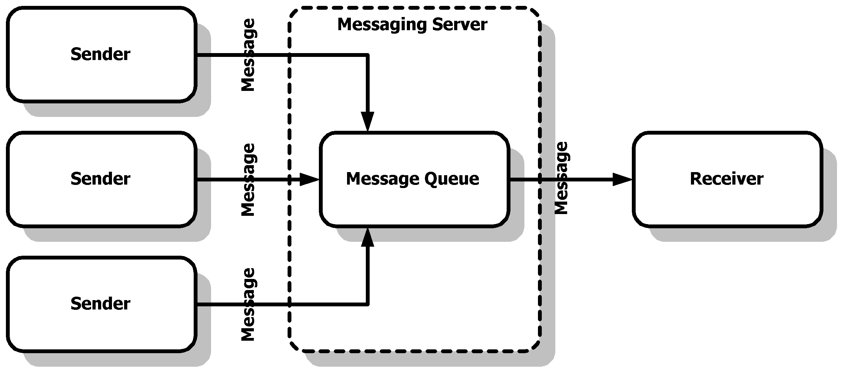
Point to Point Messaging
When a message needs to send from an application to an application, Point-to-Point messaging is used. In the simplest case, one client is the sender of the message and another client is the receiver of the message.
Any real world applications you can think off, which can use this architecture?
CPU accepting multiple processing requets; any order processing system (O2 broadband)
Notes:
[SK] Here in this diagram, Messaging server is nothing but JMS server; MOM server
Here we have complicated our architecture a little (as compared to prev. one). We have added multiple senders.
Ask group for any examples for this kind of architecture? Any business requirement utilizing this? “Quotes being sent to an exchange”; “A complex processing engine which accepts requests (computation) from senders”; A CPU accepting mutilple program requests….

Slide 12
Point to Point Messaging Cont…
MOM server Administrator creates a Queue for the P-2-P communication.
A sender client can send a message to the MOM queue and the receiver client receives the message from the MOM queue.
A message on a queue can be read by only one receiver. If a receiver has read a message from the queue, message is removed from the queue.
A sender and a receiver of a message have no timing dependencies. The receiver can fetch the message whether or not it was running when the client sent the message.
Notes:
[SK] Important thing to note here is that Queue here has a very specific meaning. One in which only one receiver is connected.
Multiple receiver queue is not called a queue. Called something else …..

Slide 13
Design Problem #3:
Bloomberg pricing server, contains prices (quotes) from a lot of Investment Banks
Retail & Institutional clients would like to subscribe to this pricing data.

Slide 14
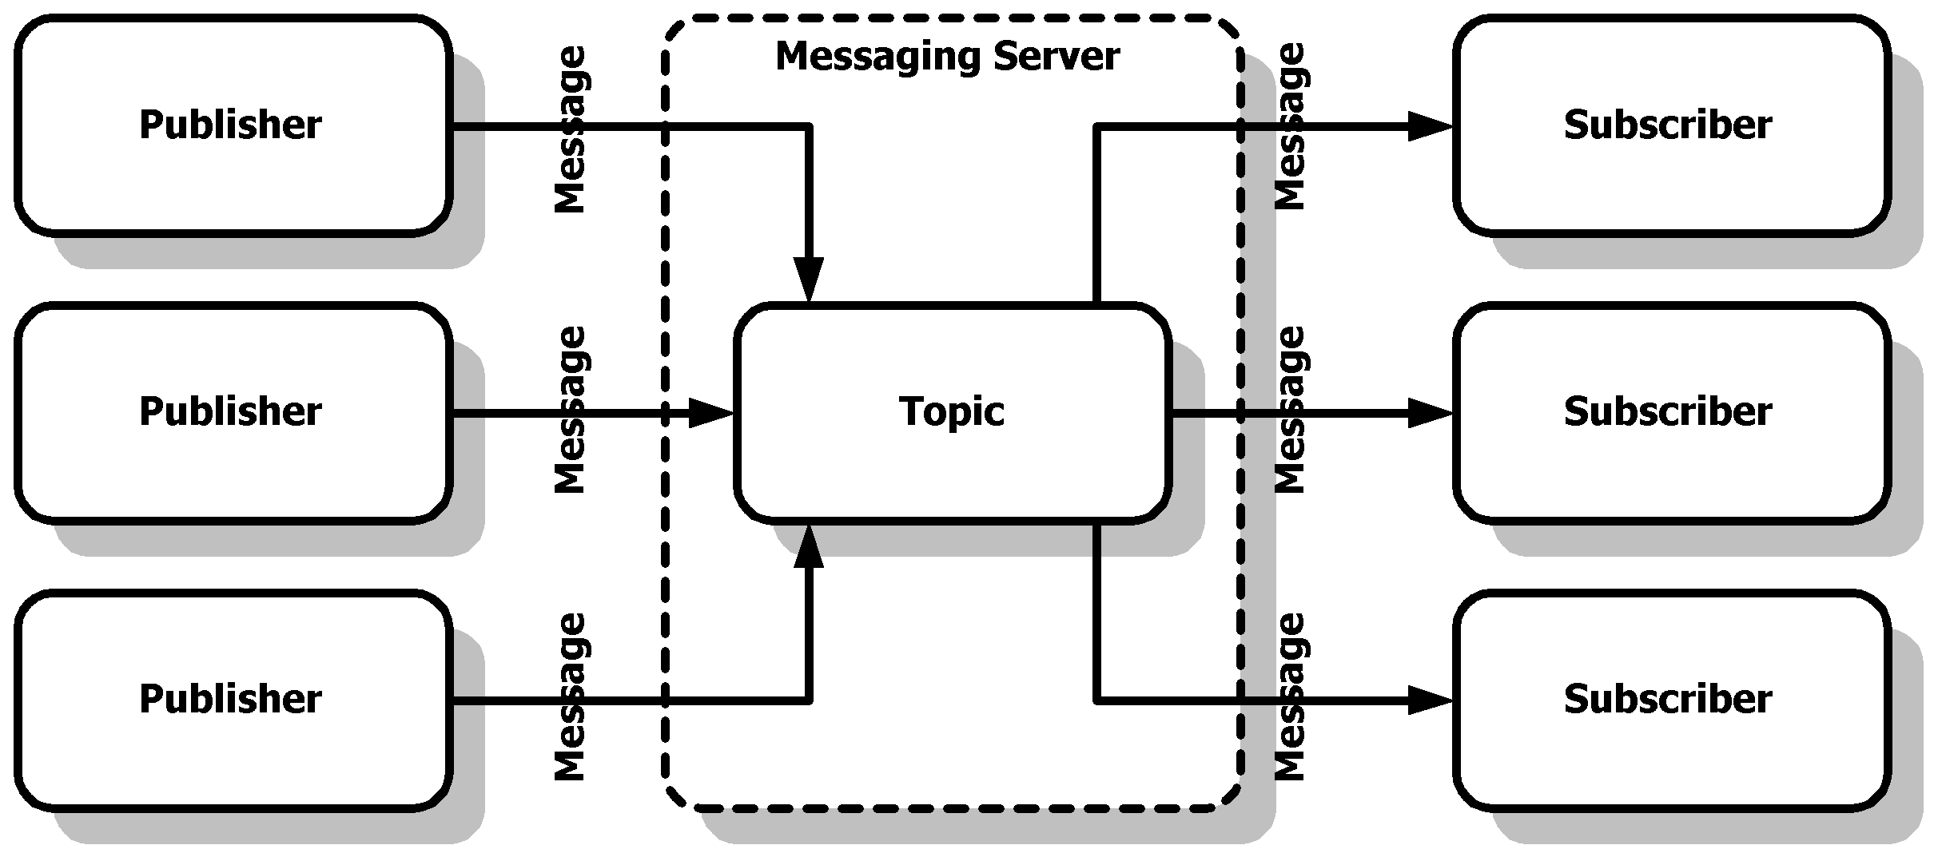
Publish-Subscribe Messaging
When multiple applications want to receive the message from the same ‘Topic’, Publish-Subscribe messaging is used.
Question: What has changed between this and the previous diagram of Point-to-Point messaging.
Any real world applications you can think off, which can use this architecture?
Twitter; Chat-Room
Notes:
[SK]
1. Not we have complicated the diagram more with additional receivers.
Messaging server here is still JMS server/MOM server. Though there are some changes ….
Ask the group to identify one change between this diagram and the previous one.
[Ans: Queue is replaced by Topic. There are multiple receivers]
2. Think of some applications/use-cases where this architecture is useful.
it’s the extension of quotes-exchange example. An exchange is publishing multiple quotes to retail/institutional clients. Left side is banks publishing their quotes data; right side is vendors like Reuters, Bloomberg consuming data.
Twitter is probably another example, though here publisher and subscriber are same people/entity (or probably one big topic where everybody is posting and messages getting persisted)

Slide 15
Publish-Subscriber Messaging Cont…
MOM server Administrator create a Topic for the Publish-Subscriber communication.
More than one sender client can publish a message to the MOM topic. All the subscriber client of that topic will receive all the messages.
The point to note in Publish-Subscribe Messaging is that, there may be multiple Senders and multiple Receivers.
(Self-study) A client that subscribes to a topic can consume only messages published after the client has created a subscription, and the subscriber must continue to be active in order for it to consume messages. To achieve time interdependency, JMS introduce a concept of durable subscription (Covered in later slides).
Notes:
[SK] Do not cover durable subscription part. No need to complicate at this point.

Slide 16
Let’s explore Active MQ …
Check Queues and Topics in Active MQ
Run sample project to send a test message to a Queue
Run sample project to send a test message to a Topic

Slide 17
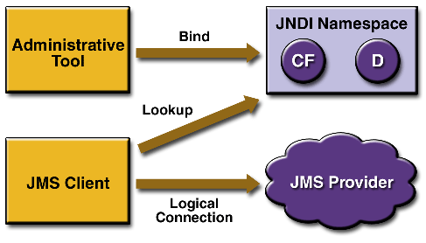
JMS API Architecture
A JMS provider is a messaging system that implements the JMS interfaces and provides administrative and control features.
JMS clients are the programs or components, written in the Java programming language, that produce and consume messages.
Messages are the objects that communicate information between JMS clients.
Administered objects are preconfigured JMS objects created by an administrator for the use of clients.
Recap Questions:
Difference between JMS Provider and MOM Server?
JNDI stands for?
Any (other) place where JNDI is typically used?
What is the benefit of using JNDI
Notes:
[SK] Lot of technical lingo here and a tricky diagram. Let’s decipher the diagram first.
JMS client is simple. It’s a client sending (or receiving) some message
what is JMS provider? Is it different from MOM server, we encountered in previous diagrams.: No, it’s the same thing
JMS client connects to provider using a 2 step process.
JMS client is doing a ‘lookup’ to JNDI (Step1) and then doing a connection (Step 2) using a ‘logical connection’ (as opposed to using a physical connection) name. Why is JMS client not directly connecting to JMS provider? Let’s first understand JNDI, without going in any depths of JNDI.
JNDI stands for “java naming and directory interface. “
It abstracts a lot of connection related information, like JMS provider IP/Port/implementation class etc. and provides a logical name to it.
And then you use the logical name in your client to ‘connect’ to this JMS provider?
Any advantages you see with this approach? (ANS: removes dependency. JMS server can migrate to a new host, for example, without impacting the jms client)
[TIP: JNDI is also typically used while doing database connections]
So in JNDI world you use JNDI API to “lookup” services and then “connect” to these services.
What is CF and D in ‘JNDI namespace’? Don’t need to worry too much about this. CF == connection factory; d == destination (queue/topic) objects
Now the last part of the diagram: Administrative tool.
What is this? What is this ‘administring’?
It is doing administration of JMS Provider. (And connecting using JNDI)
There are lot of things which needs management, in context of JMS provider. Example, setting up Queue, topics, their properties etc. …. We will see some of this in latter part of the day.

Slide 18
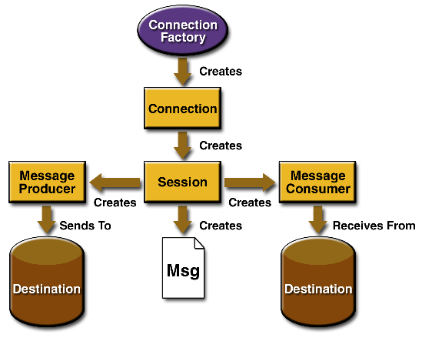
JMS Client API Programming Model
Recap Hierarchy 1: CF > C > S > MP > M > D
Recap Hierarchy 2: CF > C > S > MC > D > M
Notes:
[SK] This diagram talks about key elements (or objects) in JMS API. A programmer will have to use/create these objects in JMS world.
2 hierarcy possible here: CF > C > S > MP > M > D
CF > C > S > MC > D > M (from destination you get the message, so M is in last)
You get a connection from connection factory, which is a connection to JMS Provider/JMS Broker/JMS Server/MOM Server.
Then you create a session on the connection.
On that session you then create a Message Producer object
You create a message, which you then pass it to Message Producer object
MessageProducer then sends the message to Destination (JMSProvider)
To me, this looks like lot of objects/hierarchy to create, just to send a message. … It’s a little complex world.
Lot of boiler plate code here, which hopefully Spring should simplify.
Key things to remember:
Message is the actual message object which is sent/received
To send message, you need MessageProducer
To receiver message,you need MessageConsumer

Slide 19
Let’s see some source code …
Review sample code Queue Sender and Receiver.
Review of jndi properties

Slide 20
Administered Objects
Administered objects are preconfigured JMS objects created by an administrator for the use of clients.
Two parts of a JMS application--destinations and connection factories--are best maintained administratively rather than programmatically.
Management of these objects belongs with MOM administrative tasks that vary from provider to provider.
JMS clients access these objects through interfaces that are portable, so a client application can run with little or no change on more than one implementation of the JMS API. Ordinarily, an administrator configures administered objects in a Java Naming and Directory Interface (JNDI) API.
Technical Lingo: “Level of Indirection”
Notes:
[SK] This is a little complex slide. To simplify, think about this:
JMS is a specification. And it’s COMPLEX .. Even though it may not seem at this point ….
So there are a lot of servers/implementation to this specification.
ActiveMQ (Free) is one example. IBM Websphere MQ (Paid) is another example.
Similar to j2ee application servers: we have tomcat, ibm websphere etc.
To simplify life, we have a standard API to connect and use a JMS provider. So that client side of things do not change, say, when we migrate from ActiveMQ to Websphere, or change the port of JMS server. So that’s what last point talks about here. It also is same thing as ‘level of indirection’ – which is a technical jargon used frequently. Level of indirection is about the ability to refer something (in this case JMS object) using a name (in this case JNDI name)
It terms of administered objects, there are 2 kinds:
ConnectionFactory
Destinations (Queues and Topics)
Typically you will just use the default ConnectionFactory, so nothing much of administration here
Destinations you can create and manage in JMS Server, and then these are using JNDI, by referencing their logical names

Slide 21
Administered Object (Connection Factory)
A connection factory is the object a client uses to create a connection with a provider.
A connection factory encapsulates a set of connection configuration parameters that has been defined by an administrator.
Each connection factory is an instance of either the QueueConnectionFactory or the TopicConnectionFactory interface.
Context ctx = new InitialContext();
QueueConnectionFactory queueConnectionFactory = (QueueConnectionFactory)
ctx.lookup("QueueConnectionFactory");
TopicConnectionFactory topicConnectionFactory = (TopicConnectionFactory)
ctx.lookup("TopicConnectionFactory");
Calling the InitialContext method with no parameters results in a search of the current classpath for a vendor-specific file named jndi.properties.
Question: Why is ctx assigned to Context and not InitialContext?
Notes:
[SK] Some terms used in this slide:
ConnectionFactory: nothing but a factory object, factory produces things; in this case it produces objects, i.e. a ConnectionObject. So a CF is an object to get a Connection. Note we have to typecast it what type of desitnation object, we will use the connection for.
InitialContext class is the starting context for performing naming operations.
Context is an Interface, and InitialContext implements it.
This is basic API of JNDI.
Notice we are able to get a handle to a connection object to JMS server using just a logical name: “QueueConnectionFactory” .. That’s the benefit of JNDI. It ‘abstracts’ all implemention level details of what JMS provider, what type of connection, where to connect etc., which the client doesn’t need to know.

Slide 22
Administered Object (Destinations)
A destination is the object a client uses to specify the target of messages it produces and the source of messages it consumes. In the PTP messaging domain, destinations are called queues.
In the pub/sub messaging domain, destinations are called topics
A JMS application may use multiple queues and/or topics.
In addition to looking up a connection factory, you usually look up a destination.
Example: code performs a JNDI API lookup of the previously created topic “MyTopic” and assigns it to a Topic object:
Topic myTopic = (Topic) ctx.lookup("MyTopic");
Code to look up a queue named “MyQueue” and assigns it to a Queue object:
Queue myQueue = (Queue) ctx.lookup("MyQueue");
Notes:
[Sk] similar to connectionfactory, using JNDI to ‘lookup’ Queue/Topic, we don’t need to worry about any specific things about Queue/Topic. Just need a logical name to get a handle to the Destination.

Slide 23
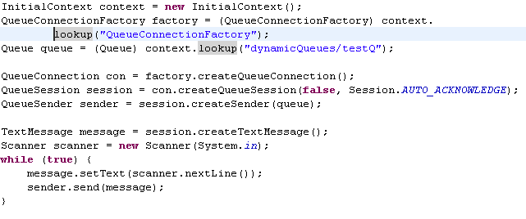
Queue Sender Example
Recall hierarchy: CF > C > S > MP > M > D
Instead of MP we have QS. QS extends MP and offers additional queue specific functionalities.
Notes:
[SK] Now we look an example on how to send a simple message to JMS Server.
It involves a lot of boilerplate code, as we have discussed factory.
Let’s recall the hierarchy which we had discussed earlier (go to slide 18)
CF > C > S > QS > M > D
(Instead of message producer, we have queuesender object. Otherwise it’s the same)
(QueueSender extends MessageProducer and just offers additional queue specific functionalities)
We need a connectionfactory, then a connection, a session, a queuesender and a message object

Slide 24
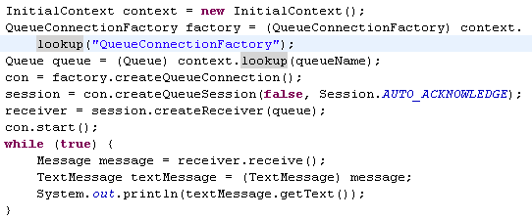
Queue Receiver Example
Recap Questions:
What is the key difference between this and previous slide
conn.start()
Where is the message coming from: JMSClient or JMSServer
Where is this process located? Same process as JVMClient or JMSServer
Receiver.receive() is an example of blocking or non-blocking call?
IMP. Self-study: How to do non-blocking call in Receiver.
Notes:
[SK] This is the receiving side of things.
Questions:
What is the key difference between this and previous slide
Where is it getting the message from : JMSClient, or JMSServer
Where is this process located? Same process as JVMClient?
What is session.autoacknowledge. --→ this is default/typical acknowledgement protocol used between client and server. Any more details, go for JMS 102
What is false parameter when we create session -→ indicates whether session is a transacted session or not. (Again for JMS 102)

Slide 25
Connections
A connection encapsulates a virtual connection with a JMS provider. A connection could represent an open TCP/IP socket between a client and a provider service daemon. We use a connection to create one or more sessions.
Like connection factories, connections come in two forms, implementing either the QueueConnection or the TopicConnection interface. For example, once we have a QueueConnectionFactory or a TopicConnectionFactory object, we can use it to create a connection:
QueueConnection queueConnection = queueConnectionFactory.createQueueConnection();
TopicConnection topicConnection = topicConnectionFactory.createTopicConnection();
Notes:
[SK] Nothing fancy here. We need a connection object to connect to : JMS Client/JMS Provider/JMS Server?

Slide 26
Connections Cont…
On application completion, we need to close any connections that we have created. Failure to close a connection can cause resources not to be released by the JMS provider.
queueConnection.close();
topicConnection.close();
Closing a connection also closes its sessions and their message producers and message consumers.
Before our application can consume messages, we must call the connection's start method. Why?
If we want to stop message delivery temporarily without closing the connection, you call the stop method.
Notes:
[SK] why should we start the connection (Point#3)?
- Part of JMS specification
- You need to start a Connection using the start() method to start allowing the flow of messages from the producer to the JMS server. When do you start the Connection?
- If you start a connection before starting the subscriber/Receiver (consumer) then the messages have to wait in the JMS server or they persist if they are durable messages, this is an unnecessary overhead so to avoid this ,first start Consumers and then start the Producer Connection.

Slide 27
Sessions
A session is a single-threaded context for producing and consuming messages.
One potential reason: Transaction behavior requirement of session may be difficult to implement due to lack of thread guarantees of running and completing it’s work
Are use to create message producers, message consumers, and messages.
Provides a transactional context with which we can group a set of sends and receives into an atomic unit of work.
Very similar (as a simple) analogy to a HTTP Session
Come in two forms, implementing either the QueueSession or the TopicSession interface.
Example, TopicConnection object created, can be use to create a TopicSession:
TopicSession topicSession = topicConnection.createTopicSession(false,Session.AUTO_ACKNOWLEDGE);
First argument means that the session is not transacted; Second means that the session automatically acknowledges messages when they have been received successfully.
Notes:
[SK] Very similar analogy to HTTP Session (if you are aware). Session is a way to group multiple send/receives to JMS server. A higher level abstraction, above individual message send/receive.
Why is this session single-threaded?
- If it is multi-threaded, how will it remember states like which messages have been read, acknowledged etc. ; will be a complex thing to do….
- No other satisfactory answer found so far …

Slide 28
Exercise
Start the jms server.
Create a sender class to send the message. (30 Minutes)
Create a receiver class to receive the message. (Self-study/Hands-on time)
Write a asynchronous class to implement jms queue. (Self-study/Hands-on time)
Notes:
For last point, async class, answer location:
D:\Sapient Office Data\0_Capabilities\SVN\Tech102\JMS 102\Examples\JMS\src\com\example\jms\_01Queue\_03AsynchronousReciever.java

Slide 29
Message Producers
A message producer is an object created by a session and is used to send messages to a destination.
The PTP form of a message producer implements the QueueSender interface.
The pub/sub form implements the TopicPublisher interface.
QueueSender queueSender = queueSession.createSender(myQueue);
TopicPublisher topicPublisher = topicSession.createPublisher(myTopic);
(Self – study) Create an unidentified producer by specifying null as the argument to createSender or createPublisher. With an unidentified producer, can wait to specify which destination to send the message to until we send or publish a message.
Notes:
[SK] PTP is point to point. (queue)
Pub/sub is Publish, subscribe. Typical for a topic
Optional coverage:
What is unidentified producer …. Is it Hidden producer?
Identified producer: if a non-null destination is specified when initializing the producer, it a identified producer. Identified in the sense that it is identified that this producer is linked to this destination and will always send messages against this destination.
An ‘unidentified’ message producer is used when a producer is used to produce messages to one or more destinations. In that case, we specify null in destination parameter, to initialize the producer.

Slide 30
Message Producers Cont…
Once created a message producer, can use it to send messages. Have to create the messages first, With a QueueSender, use the send method:
queueSender.send(message);
With a TopicPublisher, use the publish method:
topicPublisher.publish(message);
(Self – study) If created an unidentified producer, use the overloaded send or publish method that specifies the destination as the first parameter.

Slide 31
Message Consumers
Message Consumer is an object created by a session and is used for receiving messages sent to a destination.
A message consumer allows a JMS client to register interest in a destination with a JMS provider.
The PTP form of message consumer implements the QueueReceiver interface. The pub/sub form implements the TopicSubscriber interface.
QueueReceiver queueReceiver = queueSession.createReceiver(myQueue);
TopicSubscriber topicSubscriber = topicSession.createSubscriber(myTopic);
Message delivery does not begin until we start the connection created earlier, by calling the start method.
JMSClient receiving messages does not know when the message will arrive – unlike a client sending messages. Hence, MessageConsumer might have to ‘wait’. Some API related to this:
messageConsumer.receive()
messageConsumer.receive(timeout)
messageConsumer.receiveNoWait()
Notes:
[SK] MessageConsumer is reciprocal of MessageProducer.
A little variation in messageconsumer (as compared to messageproducer) is around timing aspect. In MessageProducer, we know that we will be sending the message ‘now’. In messageconsumer, we don’t know when the message will arrive. So we might have to wait. So there are some API’s related to this timing.
Example:
messageConsumer.receive()
messageConsumer.receive(timeout)
messageConsumer.receiveNoWait()

Slide 32
Exercise
Create a subscriber class to subscribe for a topic.(During hands-on time)
Create a publisher class to publish the messages on topic. (self-study)
Write a class to implement the jms topic. (self-study)
Notes:
[SK] Skip this. Better to give additional time for previous exercise.

Slide 33
Design Problem #4:
My application connects to a JMSBroker to fetch prices, which are then sent to a data provider like Bloomberg.
There are some special kind of prices, called end of day prices, which I get just once-a-day (unlike normal quote prices which I get multiple times in a second)
It is critical that I send once-a-day prices to Bloomberg successfully
I want to acknowledge back to JMSBroker for a end-of-day price, only after I have successfully sent the price to Bloomberg.

Slide 34
Message Acknowledgement
Until a JMS message has been acknowledged, it is not considered to be successfully consumed. The successful consumption of a message ordinarily takes place in three stages:
The client Receives the message
The client process the message
The message is acknowledged
Acknowledgment is initiated either by the JMS provider or by the client, depending on the session acknowledgment mode.
TopicSession topicSession = topicConnection.createTopicSession(false,Session.AUTO_ACKNOWLEDGE);
Session is not transacted
Acknowledgement Mode
Notes:
[SK] What does it mean by client processing the message? Is it just getting inside the client program enough?
What if the message is something which needs to be updated to database? Before it is persisted (or in a way processed), client would not want to acknowledge….

Slide 35
Message Acknowledgement Cont…
In transacted sessions, acknowledgment happens automatically when a transaction is committed. If a transaction is rolled back, all consumed messages are redelivered.
In non-transacted sessions, when and how a message is acknowledged depends on the value specified as the second argument of the createQueueSession or createTopicSession method.

Slide 36
Message Acknowledgement Cont…
If we start a non transacted session at the receiver end and the acknowledgement mode is “Session.AUTO_ACKNOWLEDGEMENT”, acknowledgement is done when the receiver receive the message from the destination.
If we start a non transacted session at the receiver and acknowledgement mode is “Session.CLIENT_ACKNOWLEDGEMENT”, this is the receiver responsibility to acknowledge the message.
In client acknowledgement mode, acknowledgement is done at the session level. If you have received 10 messages and you acknowledges only 4th message, all the 10 message will be acknowledged.
If a message is not acknowledged, it is delivered again when the receiver try to consume it in consequent call.
Recap Notes:
Note above (ack modes) is relevant only at receiver side of things. Not at Sender side.
Committing a message to Database before Acknowledging back, is another example for this use-case
Do you see any disadvantages of CLIENT_ACK
This will slow down message delivery (not JMS Server though)
Notes:
[SK] Note that these are receiver side of things, that I (client, receive) has received the message successfully.
Not much relevance of acknowledgement at sender side of things.
There are 2 parts to this: receiving and processing
Receiving will typically be taken care by JMS API. They will ensure a proper/correct message is received by the client.
But a client might want to do some processing first and then acknowledge back to MOM/Server. That gives the flexibility to client to re-receive the message again, suppose it’s processing fails, or, say, the program fails in between.
For example, a program that receives some data which is then persisted to DB. DB persist can fail, so to ensure that only after successful DB insert of the data, we acknowledge back to JMS server that we have successfully got the message. Now it’s OK to, say, delete the message at your end.
This operation of CLIENT_ACK seems to have a performance limitation. It will slow down message delivery (not JMS Server though)
4/10th message point is a little misleading. One wouldn’t necessarily acknowledge 4th message. One would just say acknowledge and all messages received so far will be acknowledged.

Slide 37
Exercise
Use the jms queue written before and use the different types of acknowledgement in jms.(Self-study)
Continue on your previous example. (30 minutes)
Notes:
[SK] Skip this. Keep time for one more exercise in the end.

Slide 38
Design Problem #5:
My application needs to be rebooted once a day, to clean up resources and free up some memory
My application subscribes to a Topic to receive prices which are posted from the Bank’s central pricing server.
I would like to receive prices which were posted to the JMSTopic during my application’s downtime.

Slide 39

Durable Subscriber
A non durable subscribe can get only those messages that have been published while the subscriber is alive. In contrast of non durable subscriber, durable subscriber can get a message that was published before the subscribe become alive.
TopicSession.createDurableSubscriber method is used to create a durable subscriber.
Durable subscription is configured in the MOM provider. A MOM administrator set a client id and a subscribe name for a topic.
At the receiver end, Client id needs to be set on the topic connection. Subscriber have to pass the subscription name on the session to become a durable subscriber.
Question: How to set Durable Subscription for a Queue?
Notes:
[SK] Question: will Durable Subscription be relevant for a queue?

Slide 40
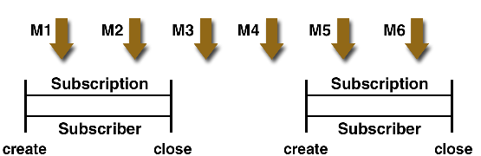
Durable Subscriber cont…
In case of non durable subscription, if a subscribe is closed, the subscription ends as well.
In above figure, the subscriber consumes messages M1, M2, M5, and M6, but messages M3 and M4 are lost.
Notes:
[SK] skip first point. Just focus on the diagram that messages will be missed because the subscriber is non-durable
[SK] Give an example where durable subscription can be used?
Durable subscription can be paid/premium service. For example, in UBS/PM2, pm2 client was non-durable.
Or where client can abnormally fail and want to get previous messages ….when it is down.
Or when a client is processing server itself. For example, in PCML, if clients send quotes on jms, and PCML is down for some odd reason, we would not want to miss important quotes from clients ….

Slide 41
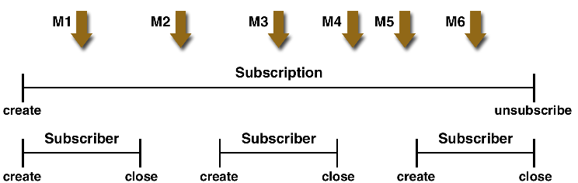
Durable Subscriber cont…
In case of durable subscription, the subscriber can be closed and recreated, but the subscription continues to exist and to hold messages until the application calls the unsubscribe method.
session.unsubscribe("testSubscriber");
In the above figure, even though messages M2, M4, and M5 arrive while the subscriber is closed, they are not lost.
Notes:
[SK] Just focus on the diagram.

Slide 42
Design Problem #6:
My application sends instrument quotes (prices) to a JMS broker.
Before I can send prices for a financial instrument (security), I need to send a ‘reservation’ request to the Pricing Server (via JMS broker), for that particular instrument
Only when I get back a successful acknowledgment from Pricing server, for my reservation request, I can send quotes to the JMS broker.

Slide 43





Reply from receiver
Sender
Message ID + Reply Queue
M
O
M
S
E
R
V
E
R
Message ID + Reply Queue
Receiver
Message Correlation ID
Message Correlation ID
Notes:
[SK] example usage in next slide

Slide 44
Reply From Receiver cont…
If a producer expect some reply from the receiver then producer can provide a destination (Queue or Topic) information to the client. This information is provided in the message header by setting a header attribute “JMSReplyTo”.
If a receiver receive the message with a message header attribute “JMSReplyTo”, receiver can send back a message to the reply destination.
To correlate a reply message at the producer end, receiver add the correlation id (JMS message header attribute) to the reply message. This correlation id is nothing but the message id of the consumed message.
Question: Any other example where you can think of using JMSReplyTo
Useful when there is a big message, sent and processed in chunks
Question: Is JMSReply relavant for topics.
It is possible to reply to Topic. Though more logical to use this in case of a queue.
Recap Note: This is a situation where 2 JMS Clients need to talk to each other. In previous cases we discussed interaction between JMS Server and Client, esp. using ACKNOWLEDGEMENT MODES.
Notes:
[SK] This can be useful when there is a big message to conveyed, sent (and processed) in chunks?
Another example can be PCML application. A client needs to exclusively ‘reserve’ an instrument so that it can contribute price. A reply can be a medium to tell if a reservation was successful and if not, what is the failure reason.
Q: can this (JMSReply) be relavant for topics?
Ans: it is possible to reply to a topic. Though typically, you would just reply back to a queue.. More logical to use queue.

Slide 45
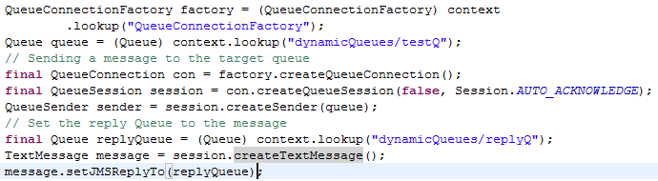
Reply from receiver (Sender Code)
Note there are 2 different queues. One to send, one to receive data.
Notes:
[SK] Note 2 different queues: one to send, one to receive data.

Slide 46
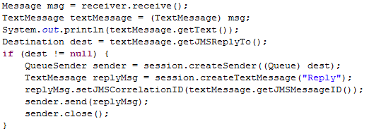
Reply from receiver (Receiver Code)

Slide 47
Design Problem #7:
My application needs to send a lot of messages (prices) to exchange.
It’s OK if one odd message is lost, speed is of essence.
How can I make JMS fast?

Slide 48
Specifying Message Persistence
The JMS API supports two delivery modes for messages to specify whether messages are lost if the JMS provider fails. These delivery modes are fields of the DeliveryMode interface.
The PERSISTENT delivery mode, which is the default, instructs the JMS provider to take extra care to ensure that a message is not lost in transit in case of a JMS provider failure. A message sent with this delivery mode is logged to stable storage when it is sent.
The NON_PERSISTENT delivery mode does not require the JMS provider to store the message or otherwise guarantee that it is not lost if the provider fails.
Question: Any disadvantages of Persistent Delivery
JMS needs to clear (manage) data storage; less throughput
Question: Any advantages of NON_PERSISTENT delivery
Low overhead; higher throughput
Notes:
[SK]
A client marks a message as persistent if it feels that the application will have problems if the message is lost in transit
A client marks a message as non-persistent if an occasional lost message is tolerable
Tradeoff: Reliability vs. Throughput
Any disadvantages of PERSISTENT delivery → need to clear data storage; less throughput.
Any advantages of NON_PERSISTENT delivery → low overhead, higher throughput?

Slide 49
Specifying Message Persistence cont…
You can specify the delivery mode in either of two ways.
You can use the setDeliveryMode method of the MessageProducer interface--the parent of the QueueSender and the TopicPublisher interfaces--to set the delivery mode for all messages sent by that producer.
If you do not specify a delivery mode, the default is PERSISTENT.

Slide 50
Design Problem #8:
My application is a Price Machine, which “calculates” price of a derived financial instrument.
To compute the derived price, I need to fetch the prices of individual securities which are available in different queues (Think of this like calculation of BSE Index),
I should not compute the derived price if one of the constituent (security) price isn’t available.

Slide 51
JMS Transaction
You can group a series of operations together into an atomic unit of work called a transaction. If any one of the operations fails, the transaction can be rolled back, and the operations can be attempted again from the beginning. If all the operations succeed, the transaction can be committed.
We can define the transaction boundaries over multiple JMS messages communication. For example, either all messages inside the transaction boundary will be delivered or no message will be delivered.
A transacted session is always involved in a transaction. As soon as the commit or the rollback method is called, one transaction ends and another transaction begins.
Recap Note: This is very similar concept to Database transaction
Notes:
[SK] JMS Transaction concept very similar to Database transaction.

Slide 52

JMS Transaction possible operation
T1
All Send
M
O
M
S
E
R
V
E
R
T2
All Receive
T3
Some Receive
Followed By
Some Send
Question: How do you configure transactions.
→ connection.createSession(boolean isTransacted, int ACK_MODE)

Slide 53
Choose the right technology: JMS/Sockets/RMI
•
2 Applications needs to communicate “synchronously”
Sockets
•
Application 1 is Java based; Application 2 is .NET based
•
Communication needs to happen as “fast” as possible
•
It’s OK to have tight coupling (sharing of business logic) across the
2 applications.
•
2 Applications needs to communicate “synchronously”
RMI
•
Application 1 is Java based; Application 2 is Java based
•
It’s OK to have tight coupling (sharing of business logic) across the
2 applications
•
Not interested in using low level programming API for
communications
•
2 Applications needs to communicate “asynchronously”
JMS
•
Application 1 is Java based; Application 2 is Java based

Slide 54
Choose the right type of JMS feature: Session.DurableSubscriber / DeliveryMode.NON_PERSISTENT /Destination.Queue / Message.timeToLive / Destination.Topic / Session.JMSTransaction /Session.CLIENT_ACKNOWLEDGEMENT / /Message.JMSReplyTo
Banks need to send prices to an Exchange
Destination.Queue
Banks need to ‘subscribe’ to an Exchange to fetch prices
Destination.Topic
Client wants to persist the message into Database before
Session.CLIENT_ACKNOWLEDGEMENT
acknowledging the message back to JMS Server
Client wans to receive messages posted on a topic, for
Session.DurableSubscriber
the time client was getting restarted (and hence unable
to receive messages)
Application 1 wants to get back an acknowledgement
Message.JMSReplyTo
that Application 2 has successfully retrieved his message
from JMS Server
Client wants to send messages to JMS Server, as fast as
DeliveryMode.NON_PERSISTENT
possible. Some message loss is acceptable.
Message on
JMSServer
should be thrown away if no
Message.timeToLive
client picks that message in, say, 1 minute, of posting the
message.
Bank wants to send message to either ALL exchanges or
Session.JMSTransaction
NONE in case any one of exchange is unable to receive
message.

Slide 55
Setting Message Priorities (Self – study)
You can use message priority levels to instruct the JMS provider to deliver urgent messages first. You can set the priority level in either of two ways.
You can use the setPriority method of the MessageProducer interface to set the priority level for all messages sent by that producer.
You can use the long form of the send or the publish method to set the priority level for a specific message. The third argument sets the priority level. For example, the following publish call sets the priority level for message to 3: topicPublisher.publish(message, DeliveryMode.NON_PERSISTENT, 3, 10000);
The ten levels of priority range from 0 (lowest) to 9 (highest).
If you do not specify a priority level, the default level is 4.
A JMS provider tries to deliver higher-priority messages before lower-priority ones but does not have to deliver messages in exact order of priority.
Question: Any example use-case where you can set Message Priorities
Pricing application which sends both instrument reservation request and contribution (pricing) request. Reservation request should take priority over Contribution.

Slide 56
Allowing message to expire (Self – study)
By default, a message never expires. If a message will become obsolete after a certain period, however, you may want to set an expiration time. You can do this in either of two ways.
You can use the setTimeToLive method of the MessageProducer interface to set a default expiration time for all messages sent by that producer.
You can use the long form of the send or the publish method to set an expiration time for a specific message. The fourth argument sets the expiration time in milliseconds. For example, the following publish call sets a time to live of 10 seconds:
topicPublisher.publish(message, DeliveryMode.NON_PERSISTENT, 3, 10000);
If the specified timeToLive value is 0, the message never expires.
When the message is published, the specified timeToLive is added to the current time to give the expiration time. Any message not delivered before the specified expiration time is destroyed.
Question: Any examples where messages should expire
Stock exchange quotes valid for some time; I want to buy this stock, order valid only for today

Slide 57
JMS Transaction Possible Operations (Self – study)
You will have no problems if the transaction consists of all sends or all receives.
Also there is no problem if the receives come before the sends.
But if you try to use a request-reply mechanism, whereby you send a message and then try to receive a reply to the sent message in the same transaction, the program will hang, because the send cannot take place until the transaction is committed.
M
O
M
S
E
R
V
E
R
T3
Some Send
Followed By
Some Receive

Slide 58
Exercise (Self – study)
Use the jms queue example created , and implement the jms transaction.

Slide 59
JMS Spring Integration (Self – study)
Integration of JMS and spring is done through using the JmsTemplate class.
JmsTemplate takes care of creating a connection, obtaining a session, and ultimately sending or receiving messages.
Spring actually comes with two JMS template classes: JmsTemplate and JmsTemplate102.
JmsTemplate102 is a special version of JmsTemplate for JMS 1.0.2 providers. In JMS 1.0.2, topics and queues are treated as completely different concepts known as domains.
In JMS 1.1+, topics and queues are unified under a domain-independent API.
JmsTemplate just like JdbcTemplate simplifies the JMS code.
A JMS template helps you to obtain and release the JMS connection and session, and sends the JMSmessage created by your MessageCreator object.
Notes:
jmsTemplate.send(destination, new MessageCreator(){
public Message createMessage(Session session) throws JMSException {
TextMessage message = session.createTextMessage();
message.setText("This is a TextMessage");
return message;
}
});
Message message = jmsTemplate.receive(destination);
if (message != null) {
if (message instanceof TextMessage) {
TextMessage textMessage = (TextMessage) message;
System.out.println(textMessage.getText());
}
}

Slide 60
JMS Spring Integration
It converts the JMS API’s JMSException hierarchy into Spring’s JMS runtime exception hierarchy, whose base exception class is org.springframework.jms.JmsException.
To use JmsTemplate, we’ll need to declare it as a bean in the Spring configuration file, below is the XML configuration.
<bean id="jmsTemplate"
class="org.springframework.jms.core.JmsTemplate">
<property name="connectionFactory" ref="connectionFactory" />
</bean>

Slide 61
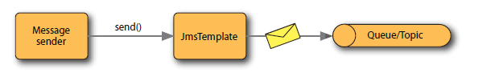
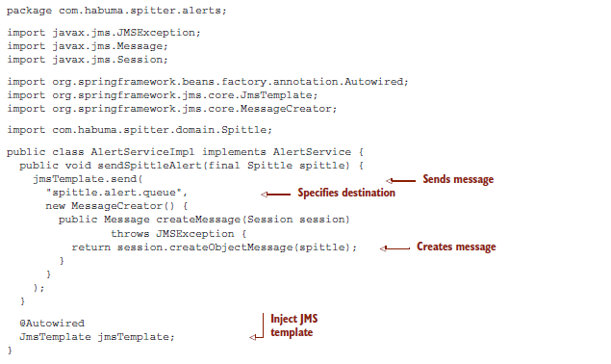
Send Message using JmsTemplate

Slide 62

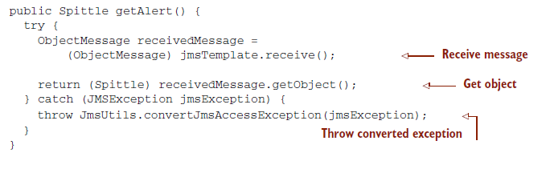
Receive Message using JmsTemplate

Slide 63
JMS Spring Integration
<bean name="connectionFactory" class="org.springframework.jndi.JndiObjectFactoryBean">
<property name="jndiName" value="QueueConnectionFactory" />
</bean>
<bean name="mailDestination" class="org.springframework.jndi.JndiObjectFactoryBean">
<property name="jndiName" value="queue/testQueue" />
</bean>
<bean id="jmsTemplate" class="org.springframework.jms.core.JmsTemplate">
<property name="connectionFactory" ref="connectionFactory" />
<property name="receiveTimeout" value="10000" />
</bean>
<bean id="messageSender" class="com.training.jms.MessageSender" >
<property name="jmsTemplate" ref="jmsTemplate"/>
<property name="destination" ref="mailDestination"/>
</bean>
<bean id="messageReceiver" class="com.training.jms.MessageReceiver" >
<property name="jmsTemplate" ref="jmsTemplate"/>
<property name="destination" ref="mailDestination"/>
</bean>

Slide 64
JMS Spring Integration(cont..)
Just like your DAO class can extend JdbcDaoSupport to retrieve a JDBC template, your JMS sender and receiver classes can also extend JmsGatewaySupport to retrieve a JMS template.
We have the following two options for classes that extend JmsGatewaySupport to create their JMS template:
Inject a JMS connection factory for JmsGatewaySupport to create a JMS template on it automatically. However, if you do it this way, you won’t be able to configure the details of the JMS template.
Inject a JMS template that is created and configured into the JmsGatewaySupport.

Slide 65
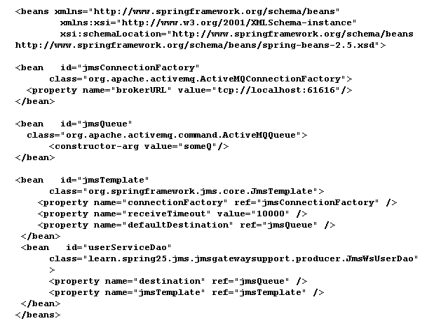
Configuration Using JmsGatewaySupport

Slide 66
JMS Spring Integration(cont..)
For Sending :
getJmsTemplate().send(new MessageCreator() {
...
});
For receiving :
MapMessage message = (MapMessage) getJmsTemplate().receive();
Spring’s JMS template can convert JMSmessages to and fromJava objects using a message converter.
By default, the JMS template uses SimpleMessageConverter for converting TextMessage to/from a string, BytesMessage to/froma byte array, MapMessage to/from a map, and ObjectMessage to/from a serializable object.
Map<String, Object> map = new HashMap<String, Object>();
map.put("mailId", mail.getMailId());
map.put("country", mail.getCountry());
map.put("weight", mail.getWeight());
getJmsTemplate().convertAndSend(map);
Map map = (Map) getJmsTemplate().receiveAndConvert();

Slide 67
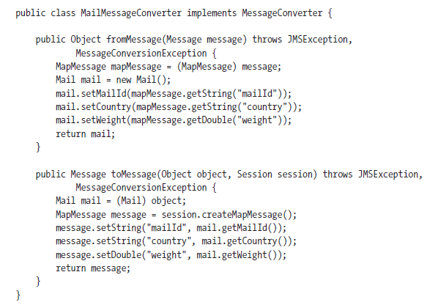
JMS Spring Integration(cont..)
We can create a custom message converter by implementing the MessageConverter interface

Slide 68
JMS Spring Integration(cont..)
To apply this message converter, you have to declare it in bean configuration files and inject it into the JMS template.
<bean id="mailMessageConverter“ class="com.training.MailMessageConverter" />
<bean id="jmsTemplate“ class="org.springframework.jms.core.JmsTemplate">
...
<property name="messageConverter" ref="mailMessageConverter" />
</bean>

Slide 69
Exercise
Rewrite a example the queue example implemented above using the JmsTemplate class and JmsGatewaySupport class.

Slide 70
Recap
JMS Introduction
Motivation for the JMS
Point to Point Messaging
Publisher Subscriber Messaging
JMS API Architecture
Administrative Objects
Other JMS Objects
Message Producer
Message Consumer
Message Acknowledge
Durable Subscriber
JMS Reply Mechanism
Message Properties
JMS Transaction
Scenarios - Recap
JMS – Spring Integration (Self – study)

Slide 71
References
www.javatpoint.com/jms-tutorial
docs.oracle.com/javaee/6/tutorial/doc/bncdq.html
www.coderpanda.com/jms-tutorial/
www.j2eebrain.com/jms-tutorial
https://dzone.com/articles/jms-application-deployment
howtodoinjava.com › JMS

Slide 72
THANK YOU

